Slide 1

Evaluation of Heart Attack Risk Factors
Jafar Vohra: Team Leader / Machine Learning Engineer
Moureen Lukoye Nampijja: Data Scientist / Data Visualizer
Smit Patel: App Developer / Data Analyst
Mahesh Potu: Researcher / Storyteller

Slide 2

The Business Problems
How can we identify the most influential factors that put cardiologist patients at a higher risk of a heart attack?
How can we provide individualized recommendations to cardiologist patients so that they can reduce their risk of heart attacks?

Slide 3

The Business Model
CRISP-DM Methodology
We have completed...
Business Understanding
Data Understanding
Data Preparation
We will continue with...
Data Modeling
Model Evaluation
Model Deployment

Slide 4
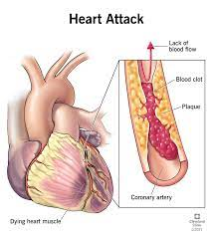
Business Understanding
Heart disease is the leading cause of death in the United States.
In the United States, someone has a heart attack every 40 seconds.
Every year, about 805,000 people in the United States have a heart attack.
605,000 are a first heart attack
200,000 happen to people who have already had a heart attack
https://www.cdc.gov/heartdisease/facts.htm

Slide 5
Data Understanding
Patient ID: Unique identifier for each patient
Age
Sex: Male/Female
Cholesterol: (mg/dL)
Blood Pressure: Systolic/Diastolic (mm Hg)
Heart Rate: (BPM)
Diabetes: (1: Yes, 0: No)
Family History: (1: Yes, 0: No)
Smoking: (1: Smoker, 0: Non-smoker)
Obesity: (1: Obese, 0: Not obese)
Alcohol Consumption: (1: Yes, 0: No)
Exercise Hours Per Week
Diet: Healthy/Average/Unhealthy
Previous Heart Problems: (1: Yes, 0: No)
Medication Use: (1: Yes, 0: No)
Stress Level: (1-10)
Sedentary Hours Per Day
Income
BMI: Body Mass Index
Triglycerides: (mg/dL)
Physical Activity Days Per Week
Sleep Hours Per Day
Country
Continent
Hemisphere
Heart Attack Risk: (1: Yes, 0: No)

Slide 6
Data Preparation
Using LabelEncoder() from sci-kit learn module in Python:
Sex: (Male/Female) → → → Sex: (1: Male, 0: Female)
Diet: (Healthy/Average/Unhealthy) → → → Diet: (2: Unhealthy, 1: Healthy, 0: Average)
Using str.split() in Python: Blood Pressure: Systolic/Diastolic (mm Hg)
Systolic Blood Pressure: (mm Hg)
Diastolic Blood Pressure: (mm Hg)

Slide 7

Tools and Technology Used
Business Understanding:
https://www.kaggle.com/
https://www.cdc.gov/heartdisease/
Data Understanding:
Seaborn
Plotly
Matplotlib
Data Preparation:
Pandas
Sci-kit learn

Slide 8
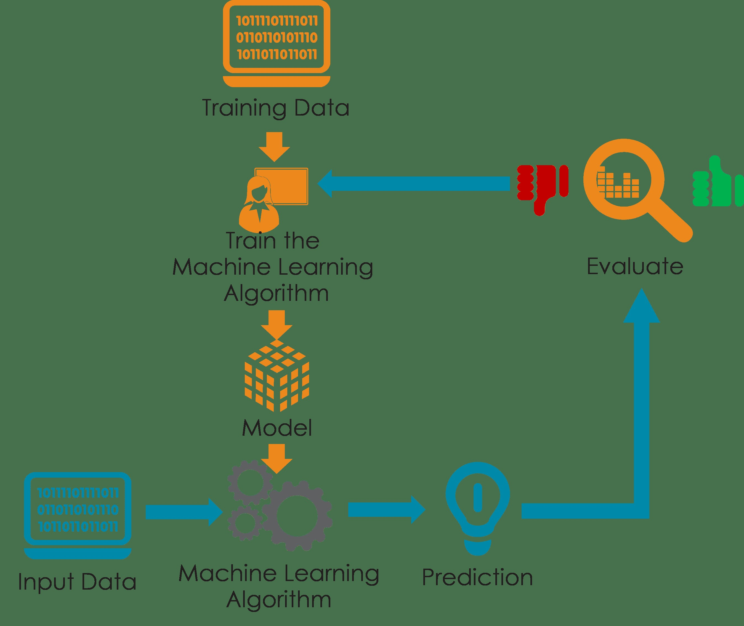
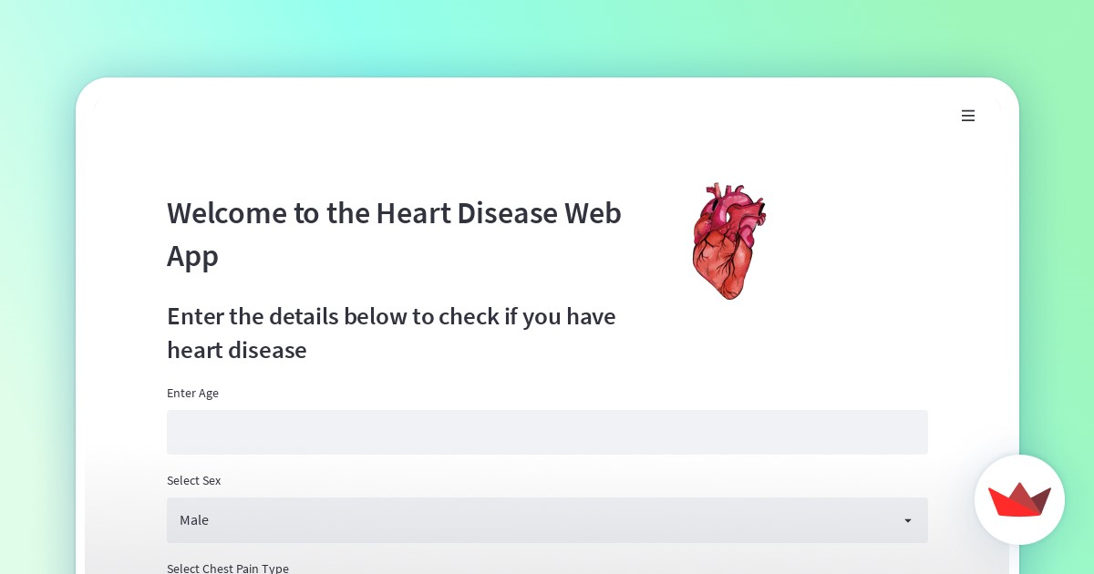
Defining & Measuring Success
Model that can accurately identify contributing factors to heart attacks
Web Application that can recommend the best heart attack risk mitigations

Slide 9
Our Milestones
Milestone #1
Explore the available data further, create visualizations to understand the underlying trends, and possibly create more features that will be included in the model.
Milestone #2
Build several machine learning models to accurately model the data it is tested against, minimizing false positive and false negative rates in the confusion matrix.
Milestone #3
Implement of a simple web application through Flask to learn the proper usage and capabilities of the framework before building up our application's complexity.

Slide 10






Our Roadmap
At-a-glance
Preparing
Exploring
Modeling
Evaluating
Deployment
Detailed project plans created
Data is searched for trends
Numerous models are built
Model tested for accuracy
Application built around model
2023
2023
2023
2023
2023
Aug-Sept
Sept-Oct
Oct-Nov
Nov
Nov-Dec

Slide 11


